Slide 1
Data Science Capstone Project
Doğukan Aytekin – 2200356003
Yurdaer Özdağ -

Slide 2
Purpose of the Project
Detect anomalies in ECG signals by analyzing heartbeat patterns.
Using these anomalies help professionals to identify potential arrhythmias and underlying heart conditions.

Slide 3
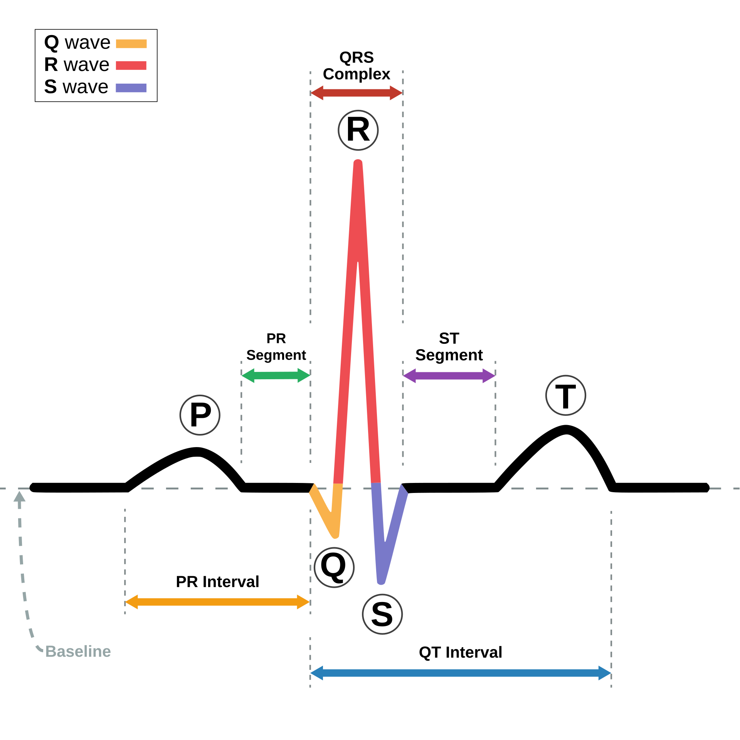
Heartbeat and ECG Signal Structure
An ECG (Electrocardiogram) shows the heart's electrical activity. It has three main parts.
P Wave: Shows the atria contracting (top part of the heart).
QRS Complex: Shows the ventricles contracting (bottom part of the heart).
T Wave: Shows the ventricles resting after contraction.

Slide 4
Types of Heartbeats :
N (Normal): Represents a normal heartbeat where the heart functions properly.
A (Atrial Premature Beat): An early heartbeat originating from the atria.
V (Ventricular Premature Beat): An early heartbeat originating from the ventricles, often associated with heart conditions.
F (Fusion Beat): A combination of a normal heartbeat and a premature beat, typically from the ventricles.

Slide 5
Heartbeat Types and Their Potential Diseases
A (Atrial Premature Beat): Can indicate atrial fibrillation, atrial flutter, or other atrial arrhythmias.
V (Ventricular Premature Beat): Can be a sign of ventricular arrhythmias, heart failure, or ischemic heart disease.
F (Fusion Beat): May occur in various conditions, including heart disease or during arrhythmia treatments.

Slide 6

MIT-BIH Arrhythmia Database
The MIT-BIH Arrhythmia dataset is widely used for heart disease detection and arrhythmia classification. It includes ECG recordings of 48 patients, containing various types of arrhythmias. The dataset is provided in two main file formats : CSV and TXT.
Each of which is a 30-minute echocardiogram from a single patient .
Data was collected at 360 Hz, meaning that 360 data points is equal to 1 second of time.
Dataset Link:
https://www.kaggle.com/datasets/protobioengineering/mit-bih-arrhythmia-database-modern-2023/data

Slide 7
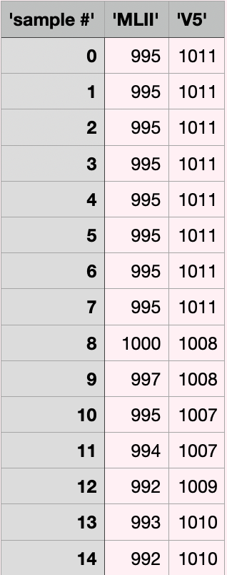
CSV files
The CSV files contain ECG data with two main columns: one for the ECG signals from MLII and another from the V5 lead. The rows represent the samples or time points, and each sample contains the signal values at that particular moment.

Slide 8
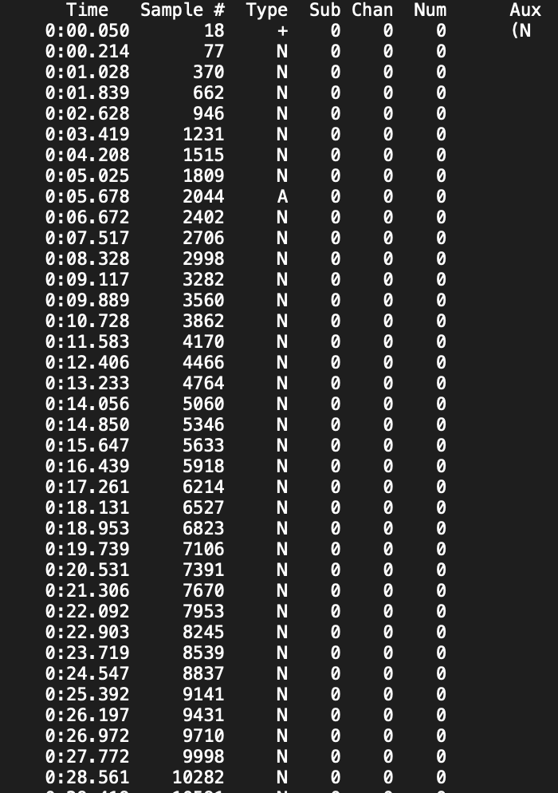
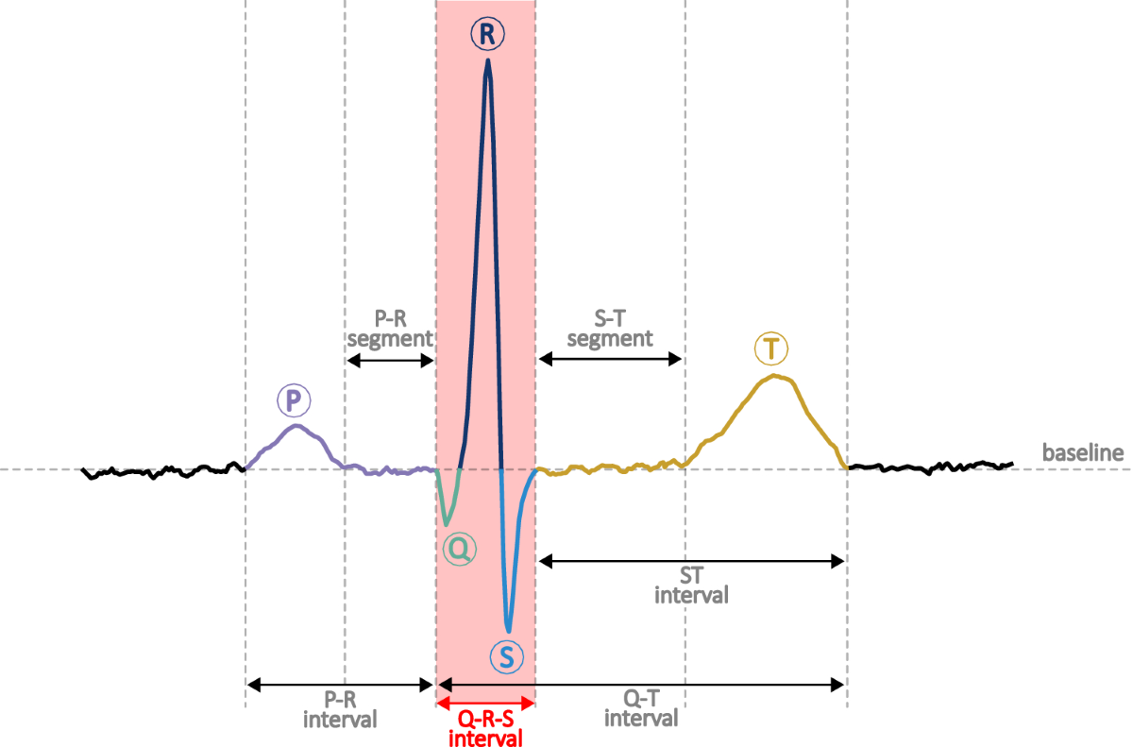
TXT files
The TXT files contain annotations with timestamps for each R-peak in the ECG signal and the corresponding beat type
These annotations allow the classification of different types of arrhythmias.

Slide 9
The CSV files are used for input to models, containing the raw ECG signals, while the TXT files provide the ground truth labels (beat types) for training and evaluation.

Slide 10
Methodology
1-Remove Noise and Artifacts from Data (Wavelet Transform)
2-Segment Data
3-Balance Data
4-Feature Extraction
5-Feature Reduction
6-Classification

Slide 11
1-Remove Noise and Artifacts from Data (Wavelet Transform)
We implemented wavelet-based denoising using the Symlet-4 (sym4) wavelet transform, which is specifically optimized for ECG signal processing.
The process involves decomposing the signal into multiple frequency bands, applying a threshold to remove noise components while preserving the important ECG characteristics, and then reconstructing the clean signal.
Using a threshold value of 0.04 and sym4 is a best practice for cleaning noise in ECG signals. We effectively removed high-frequency noise

Slide 12
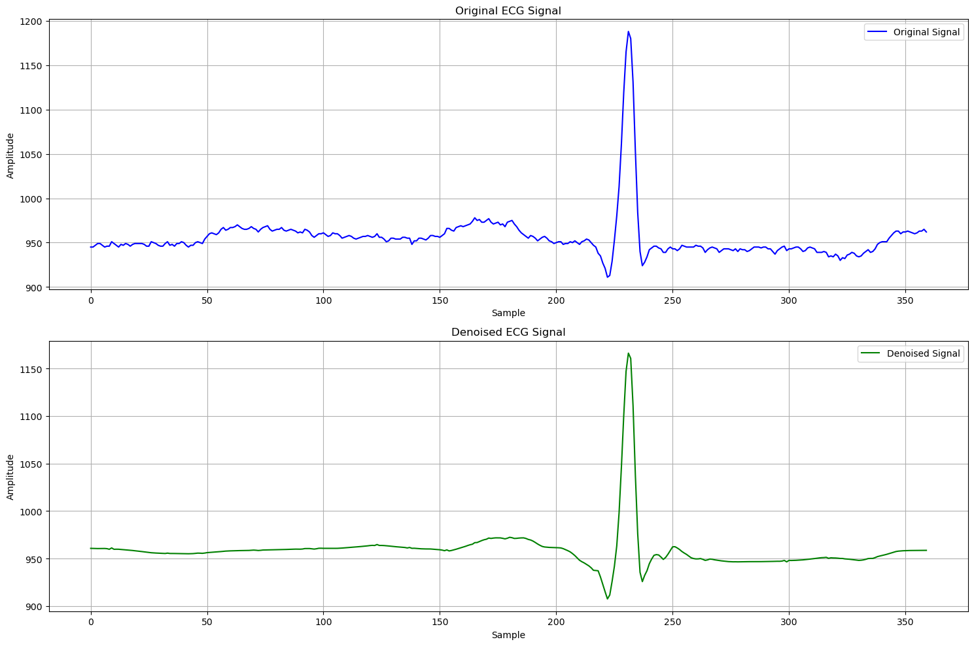

Slide 13
2-Segment Data
In our signal segmentation phase, we implemented a window-based approach to extract individual heartbeat segments from the continuous ECG recordings.
We used a window size of 180 samples on each side of the detected R-peaks (360 samples total), which was determined through research to be optimal for capturing complete heartbeat morphology.

Slide 14
3-Balance Data
Our initial dataset exhibited significant class imbalance, with the normal beats (N) being heavily overrepresented (75,011 samples) compared to other classes like fusion beats (F) with only 802 samples.
To address this imbalance, we implemented a strategic resampling approach. We set a target of 7,000 samples per class, which was determined through experimental optimization by us.

Slide 15
 | N (Normal) | A (Atrial Premature Beat) | V (Ventricular Premature Beat) | F (Fusion Beat) | f (Undefined Beat)
Before Resampling | 75011 | 2546 | 7129 | 802 | 982
After Resampling | 7000 | 7000 | 7000 | 7000 | 7000

Slide 16
4-Feature Extraction
To extract meaningful features from the input signal, we implemented a BiLSTM-based model. This model utilizes two Bidirectional LSTM layers, each designed to capture temporal dependencies and bidirectional patterns in the data.
The output from the final BiLSTM layer is flattened using a Flatten Layer, which reshapes the data for downstream processing.
The model outputs a total of 2800 features, which serve as high-dimensional representations of the input signals.
Accuracy of the BiLSTM model : 0.9348

Slide 17
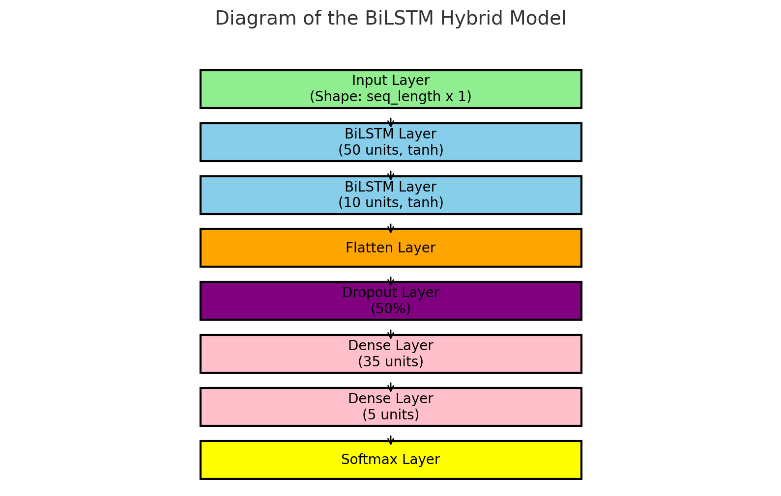

Slide 18
5- Feature Reduction
To reduce the dimensionality of the extracted features, we employed Principal Component Analysis (PCA).
The primary goal of this step is to maintain the most significant features while eliminating redundancy, thereby optimizing the model's performance in terms of accuracy and processing time.
After applying PCA, the feature space was reduced from 2800 dimensions to 63 dimensions

Slide 19
6- Classification
In the final stage of our hybrid model, we use a Random Forest Classifier to classify the processed signals.
We set the n_estimators parameter to 180, which represents the number of decision trees in the forest. This value was selected based on experimental results, balancing accuracy and computational efficiency.
The classifier takes the 63-dimensional feature set obtained from the PCA step as input.

Slide 20
Hybrid Model Architecture
PCA
(n_components=0.9)
RandomForest
(n_estimators = 180)
BiLTSM
Feature Extraction
Feature Reduction
Classification
Balanced Data
(360 features)
Data
(7200 features)
Data
(63 features)
Classified Data

Slide 21
Evaluation
This comparison clearly demonstrates the advantages of our hybrid model, which not only improves processing speed by approximately 2.5 times but also achieves higher accuracy, making it an optimal choice for real-world applications.
The combination of balancing data , BiLSTM for feature extraction and PCA for dimensionality reduction significantly enhances efficiency without compromising accuracy.

Slide 22
 | Accuracy | Training and Prediction time
Hybrid Model | 98.59% | 19.75 seconds
Baseline Model (Balanced Data) | 98.56% | 46.87 seconds
Baseline Model (Raw Data) | 98.07% | 584.91 seconds

Slide 23
